Slide 1
CS 447/647
Booting and System Management

Slide 2
Overview
Finding, loading, and running bootstrapping code
Finding, loading, and running the OS kernel
Running startup scripts and system daemons
Maintaining process hygiene and managing system state transitions
Notes:
Instructions to identify the configured bootable partition, then load and execute its volume boot record (VBR) as a chain loader.
kernel is loaded. Proceeds without external input. Firmware loads simple program located, most often, on disk. (Operating System not Found)
OS Kernel the bootloader finds it’s configuration and interprets it. It can proceed without external input but can be interrupted
Startup scripts, first initramfs then on the root filesystem. Systemd now, System V previous, upstart a while ago and launchd on macOS.

Slide 3
Virtual Machine Boot
BIOS or UEFI
Bootloader (GRUB)
Kernel and initramfs
initramfs init (shell script)
systemd init
Notes:
initramfs is for loading kernel modules dynamically and finding the rootfs to mount
init is pid 1 because it’s the first process to run during boot
Systemd was developed initially by one guy who worked at red hat
He now works at microsoft
Microsoft now has their own linux distribution (Azure Linux)

Slide 4
Booting
Power-on
Power-on Self Test
First Stage Bootloader
Second Stage Bootloader
Kernel starts
Kernel loads drivers and initializes hardware
init starts
system processes / daemons start
DNS server starts and binds network socket
DHCP server starts
physical
userspace
Notes:
First stage bootloader is the first 512 bytes of the boot drive; indicates where to jump to for stage 2
Second stage bootloader loads kernel and initramfs

Slide 5
Early boot process
“Administrators have little direct, interactive control over most of the steps required to boot a system.”
Basic Input Output System (BIOS) or Unified Extensible Firmware Interface (UEFI)
BIOS is legacy
UEFI is the current revision of EFI
Power-On Self Test - P.O.S.T
Short Test of Hardware
Processors, RAM and Graphics (GPU)
Compatibility
Notes:
I disagree with the first point. There is a significant amount of control in the BIOS.
POST powers everything on. Firmware codes, beeps.
Basic Input Output System
Unified Extensible Firmware Interface (UEFI)

Slide 6
BIOS - Basic Input Output System
1st time hardware meets software
lowest level software
Created in 1975
Real Mode - 16-bit
Backwards Compatibility
Provides
USB Support
Boot Priority
Boot Menu
PCI Configuration
CPU + RAM Configuration
Notes:
Hardware meets software. Created in the 1980’s by IBM. 32 bit values for starting offset and length of a partition
446 bytes – Bootstrap.
64 bytes – Partition table.
2 bytes – Signature

Slide 7
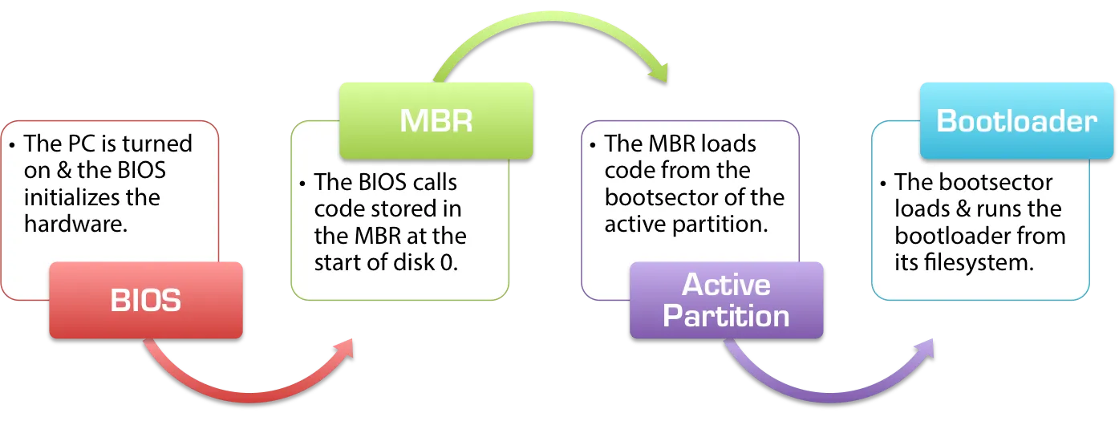
“The BIOS/MBR Boot Process.” NeoSmart Knowledgebase, 28 Feb. 2015, neosmart.net/wiki/mbr-boot-process/.

Slide 8
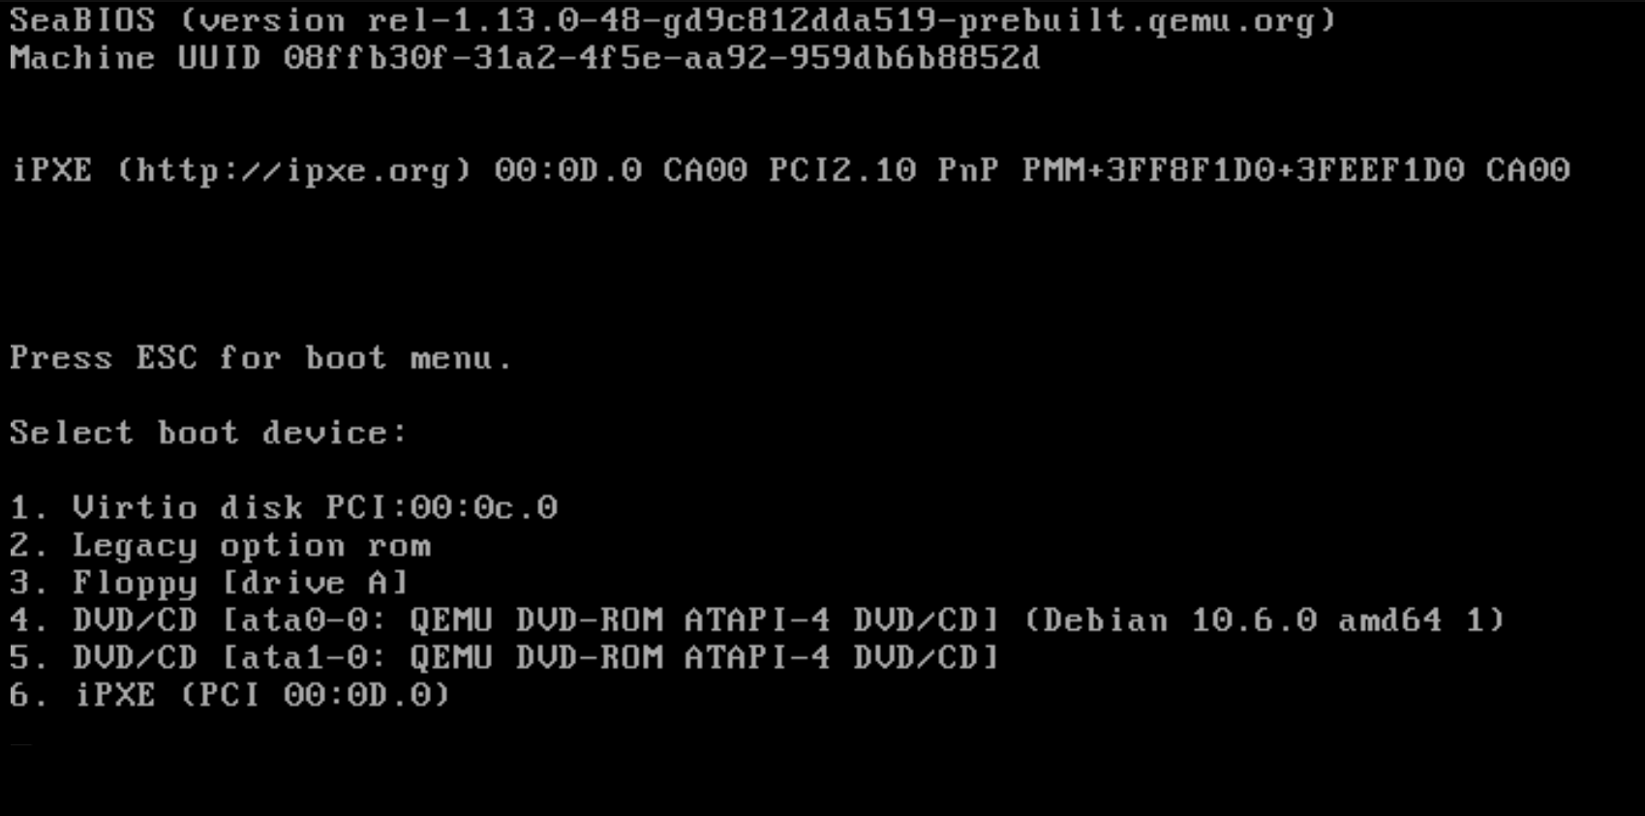
Why is BIOS important?
It is still used today.
Legacy Mode
Virtual Machines - QEMU
https://github.com/coreboot/seabios

Slide 9
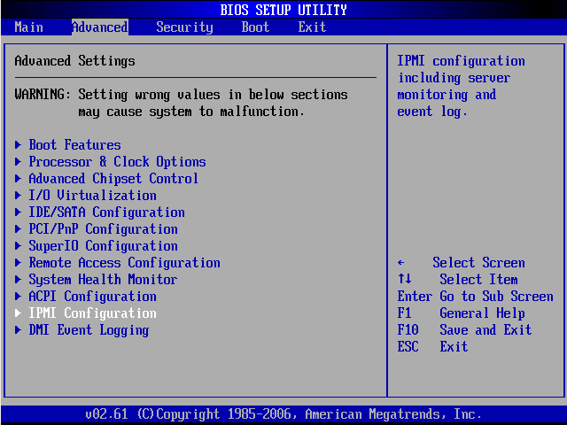

Slide 10
BIOS+MBR
Stage 1 - Boots with Master Boot Record (MBR)
Boot block - The first 512B (446B for bootstrapping) of the disk
Stage 1.5- core.img
Drivers for the Filesystem
Before the 64th disk block. ~32Kb of storage
1MiB Reserved for “stuff”
Partition selected by the “boot” flag
Stage 2 - Execute the bootloader (GRUB).
Chainloading
Downsides
Maximum disk size <= 2TiB
Hardware support.
4 primary partitions
dd if=/dev/vda of=/tmp/mbr.bin bs=512 count=1
Notes:
Created in the 1980’s by IBM. 32 bit values for starting offset and length of a partition
446 bytes – Bootstrap.
64 bytes – Partition table.
2 bytes – Signature
GPT 128 primary partitions, no limit on disk size

Slide 11
fdisk -l ./mbr.bin Disk ./mbr.bin: 512 B, 512 bytes, 1 sectors Units: sectors of 1 * 512 = 512 bytes Sector size (logical/physical): 512 bytes / 512 bytes I/O size (minimum/optimal): 512 bytes / 512 bytes Disklabel type: dos Disk identifier: 0xc8571a47
Device Boot Start End Sectors Size Id Type ./mbr.bin1 * 2048 134217727 134215680 64G 83 Linux

Slide 12
UEFI - Unified Extensible Firmware Interface
GUID Partition Table
Modern disk partitioning scheme
EFI System Partition (ESP) - FAT32 partition for grub, kernels and initramfs
No bootloader is technically required
Most use a bootloader for legacy support
EFISTUB - https://wiki.archlinux.org/index.php/EFISTUB
Provides a shell
Modify variables
Partitioning programs
Loading drivers
Edit files
Intel, ARM, AMD, AMI, Apple, Dell, Microsoft, IBM, Lenovo, HP
efibootmgr(8)
Notes:
Board of Directors
9.4 zettabytes
Bootloader is useful for loading kernel modules like proprietary modules (nvidia, mellanox, etc.)

Slide 13
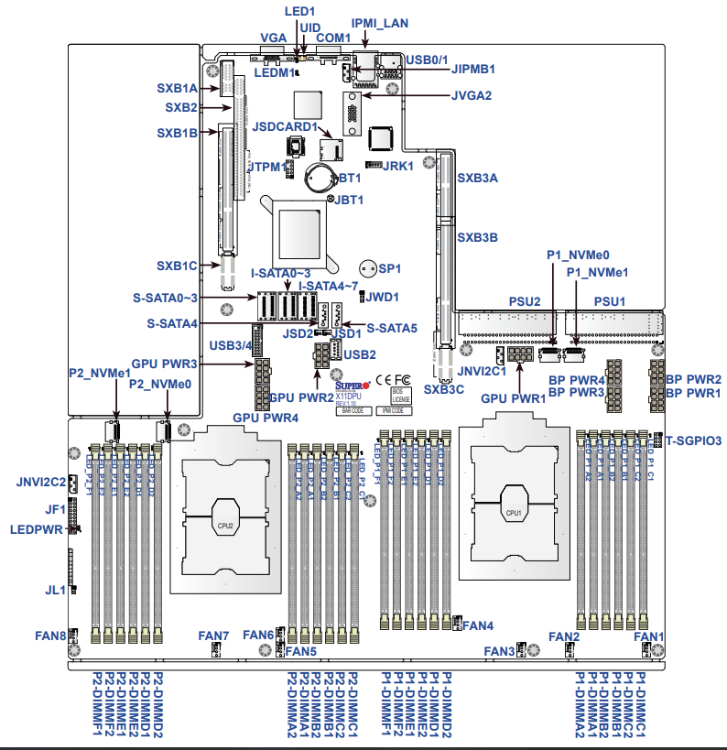
Notes:
SuperMicro Motherboard - Whitebox board

Slide 14
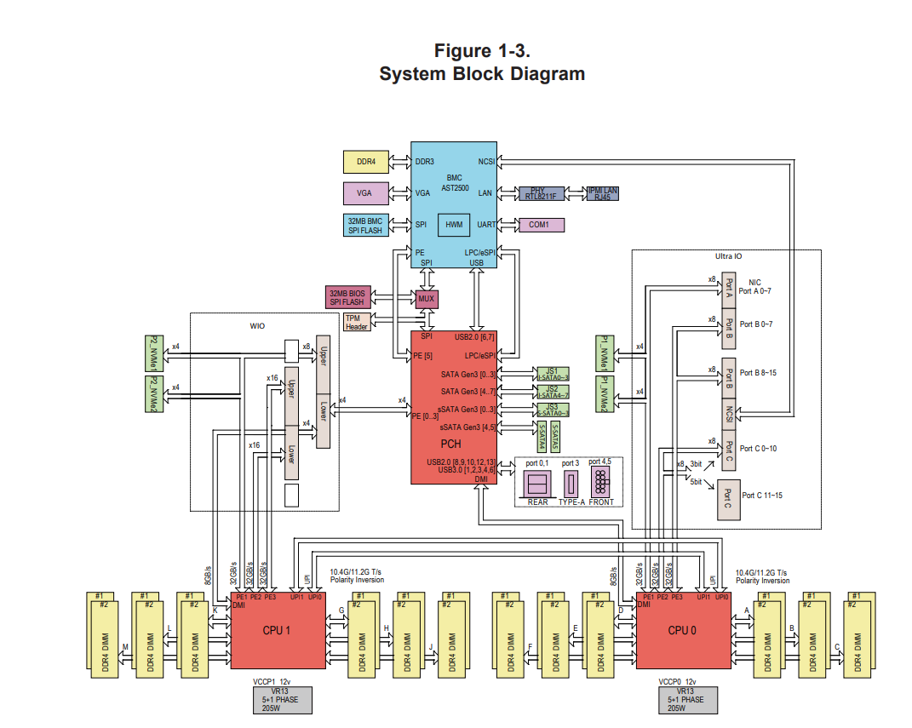
Notes:
Block Diagram.

Slide 15
Virtual Machine
qemu-system-x86_64 -enable-kvm \
-name test \
-m 2048 \
-smp 4,sockets=1,cores=4,threads=1\
-vga std \
-usb \
-drive if=pflash,format=raw,readonly,file=/usr/share/OVMF/OVMF_CODE.fd \
-drive if=pflash,format=raw,file=/var/local/OVMF_VARS_n.fd \
-drive format=raw,media=cdrom,readonly,file=ubuntu.iso \
-drive file=/var/local/n.img,if=virtio \
-cpu host,kvm=off
Notes:
-enable-kvm Kernel Based Virtual Machine, Use CPU HVM feature to do virtualization. Symmetric multiprocessing

Slide 16
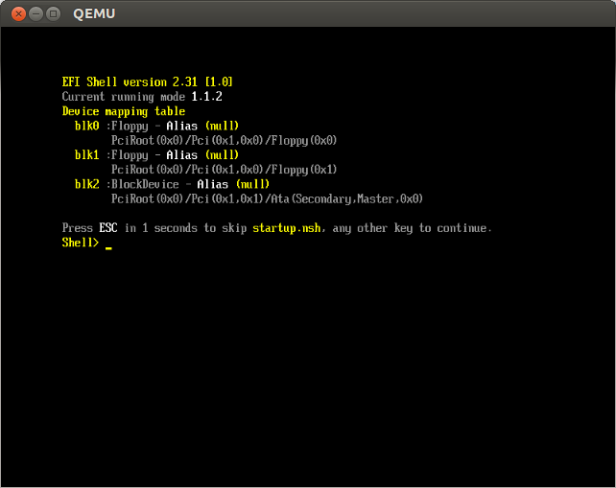
Notes:
Virtual Machine UEFI shell
Skipping efibootmgr - Read the book. Understand it’s for modify EFI boot order and options

Slide 17
GRUB- GRand Unified Boot loader
Available in Ubuntu since 9.10 (October 2009)
LILO prior
grub2 the default
grub-pc for BIOS
grub-efi for EFI
/boot/grub/grub.cfg stores the menu
Most distro’s include scripts for generating a grub.cfg
grub-mkconfig - Generates a config to stdout
update-grub2 - iterates over partitions and kernels to create a menu
grub-install - installs the stage1 and stage 1.5 bootloader
Notes:
LILO (Linux Loader) was the older linux bootloader.

Slide 18
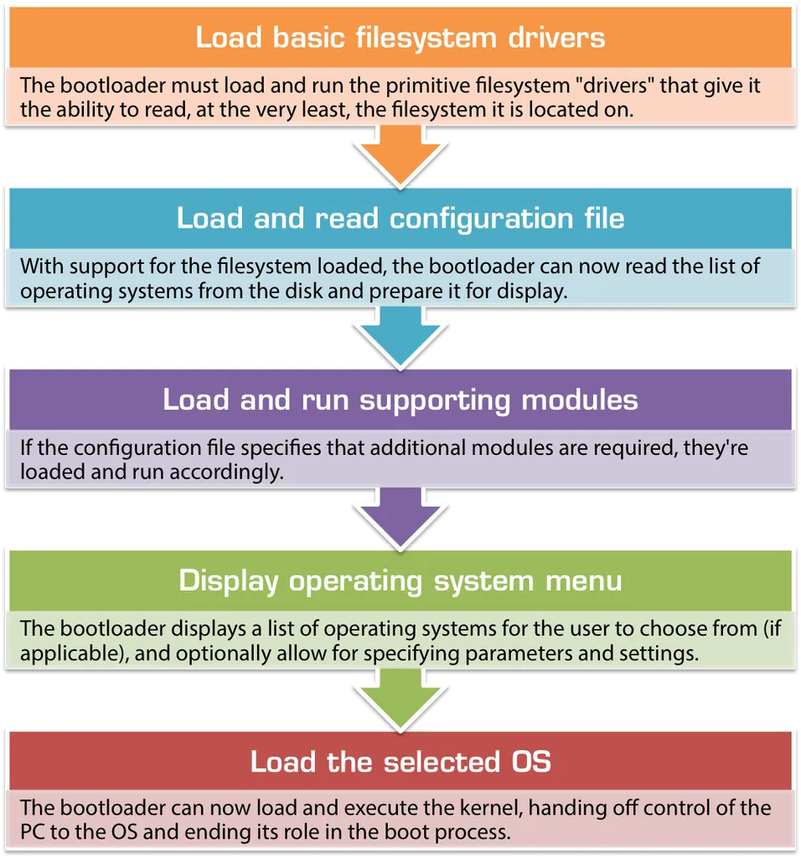
“The BIOS/MBR Boot Process.” NeoSmart Knowledgebase, 28 Feb. 2015, neosmart.net/wiki/mbr-boot-process/.

Slide 19
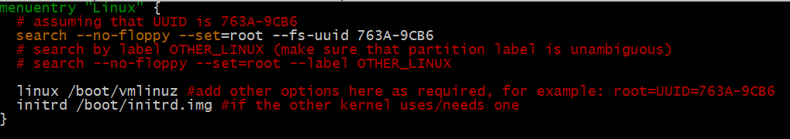
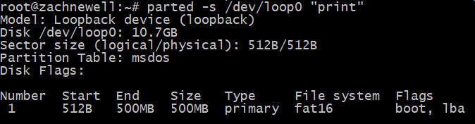
https://wiki.archlinux.org/index.php/GRUB#Boot_menu_entry_examples
Notes:
Path to kernel
Path to initramfs

Slide 20
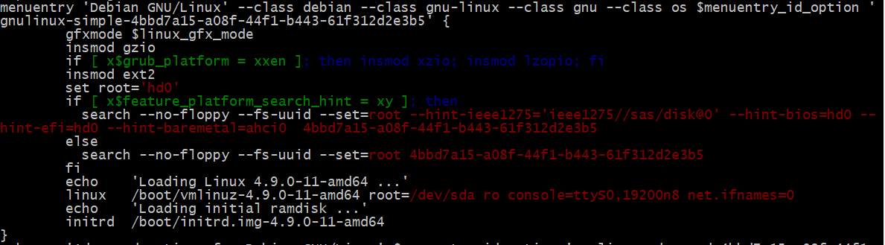
What a update-grub2 grub.cfg looks like...
--id may be used to associate unique identifier with a menu entry. GRUB_DEFAULT
Allows grouping of entries
Defaults to auto or text.
Dynamically inserts a grub module.

Slide 21
insmod
Important ones:
Filesystem: fat.mod, ntfs.mod, ext2.mod, exfat.mod, xfs.mod, zfs.mod
Block Device: mdraid1x.mod, lvm.mod
Compression: lzopio.mod, gzio.mod, xzio.mod
Important: serial.mod, luks.mod
Windows
Notes:
This module provides support for reading and writing (I/O) files that are compressed with lzop. "lzop" is similar to Gzip and uses the LZO compression library.

Slide 22
linux kernel_filepath kernel_args
Path to the initial RAM filesystem initramfs
Notes:
ro - read only
root - path to root fs
console - configures a serial port for TTY
net.ifnames - configure eth0 instead of predictable interface

Slide 23
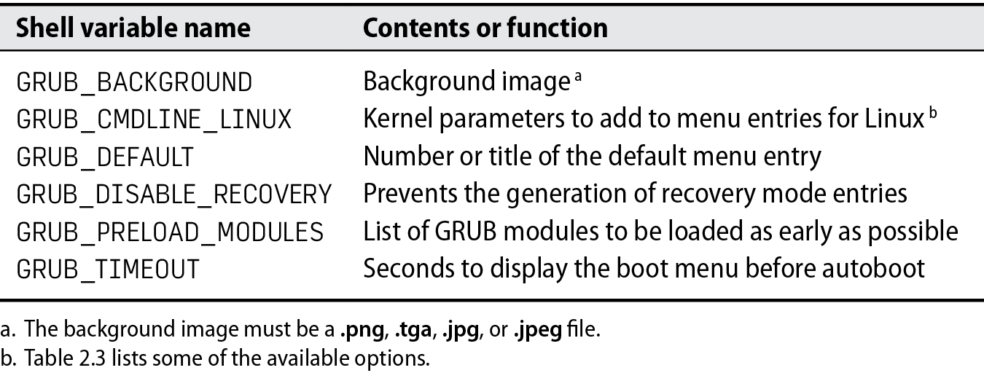
GRUB - /etc/default/grub

Slide 24
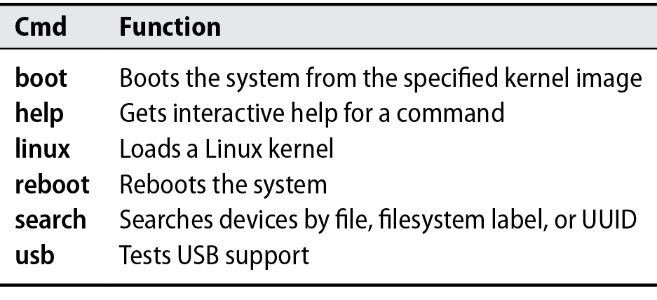
grub2 commands
Notes:
GRUB 2 has more reliable ways to find its own files and those of target kernels on multiple-disk systems, and has commands (see search) to find devices using file system labels or Universally Unique Identifiers (UUIDs).

Slide 25
Kernel
Interface between hardware and software.
Drivers - SATA, SCSI, USB, PCIe, RAID
Monolithic
Modular, lsmod, rmmod insmod, and modprobe
Provides interfaces to hardware and low-level systems
System Calls
/sys/devices
Notes:
The kernel controls everything

Slide 26
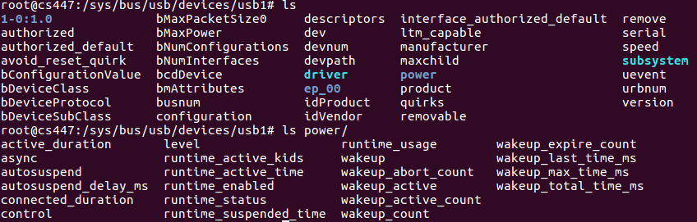

Slide 27
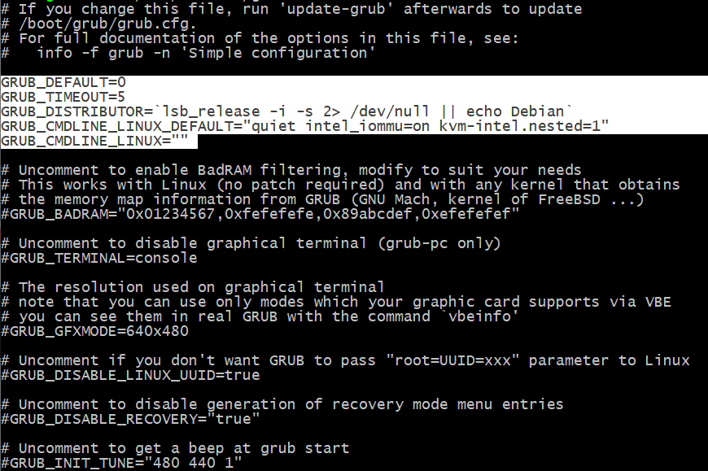

Slide 28
#Disable most log messages GRUB_CMDLINE_LINUX_DEFAULT="quiet"
#Disable power conservation GRUB_CMDLINE_LINUX_DEFAULT="intel_idle.max_cstate=0 processor.max_cstate=1 intel_pstate=disable"
#Change init GRUB_CMDLINE_LINUX_DEFAULT="init=/bin/bash"

Slide 29
U-Boot
Open-Source Stage 2 Bootloader
Primarily for embedded Linux
ARM
Uses a UART or Serial Port for output
Supports
DHCP - Dynamic Host Control Protocol
TFTP -Trivial File Transfer Protocol
GPIO Manipulation - General Purpose Input Output
MMC - Block device
Networking - UDP, ICMP, ARP
Loading the kernel over serial via modem commands
Notes:
Tftp - networking
UDP only - no TCP

Slide 30
initramfs
The initramfs is a gzipped cpio archive.
At boot time, the kernel unpacks that archive into a RAM disk,
It mounts and uses it as initial root file system.
The finding of the root device happens in this early userspace.
Generated with update-initramfs
/etc/initramfs-tools/update-initramfs.conf
man update-initramfs 5
man update-initramfs 8
Notes:
Book glosses over the initramfs
5 File formats and conventions
8 System administration commands and daemons

Slide 31
Why cpio?
It’s a standard format. Device Drivers. 1996
Not as popular as tar because the cmdline arguments are horrendous.
Simpler and cleaner
Spec is 26k of text
tar hasn’t been standardized.
Kernel internal format. Already existed inside the kernel.
Al Viro (kernel developer) made the decision
"tar is ugly as hell and not going to be supported on the kernel side"
https://www.kernel.org/doc/Documentation/filesystems/ramfs-rootfs-initramfs.txt
Notes:
Tar has different versions between linux, bsd, etc.

Slide 32
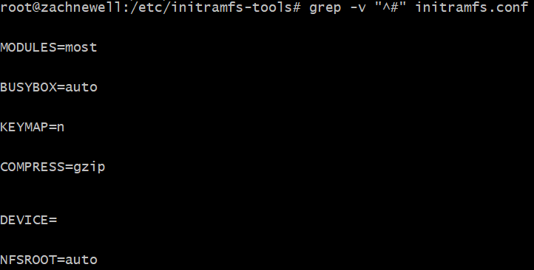
initramfs
Notes:
#
# MODULES: [ most | netboot | dep | list ]
#
# most - Add most filesystem and all harddrive drivers.
#
# dep - Try and guess which modules to load.
#
# netboot - Add the base modules, network modules, but skip block devices.
#
# list - Only include modules from the 'additional modules' list
#
# BUSYBOX: [ y | n | auto ]
#
# Use busybox shell and utilities. If set to n, klibc utilities will be used.
# If set to auto (or unset), busybox will be used if installed and klibc will
# be used otherwise.
##
# COMPRESS: [ gzip | bzip2 | lzma | lzop | xz ]
#
#
# DEVICE: ...
#
# Specify a specific network interface, like eth0
# Overridden by optional ip= bootarg
#

Slide 33
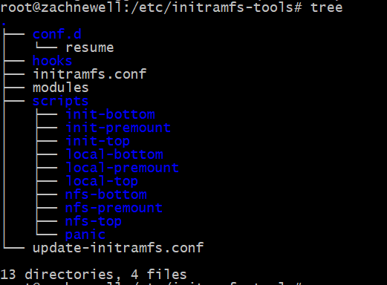
initramfs

Slide 34
busybox
Swiss Army Knife of Embedded Linux
Combines tiny versions of many common UNIX utilities
ls, bash(ash), cat, chown, chmod, mv, uniq, less, mount, umount
Multi-call binary
/bin/busybox ls
Symlinked to /bin, IE: ln -s /bin/busybox /bin/ls
Can be compiled with a different number of functions
Ubuntu by default has a lot less in initramfs-tools.
Why?
Small

Slide 35
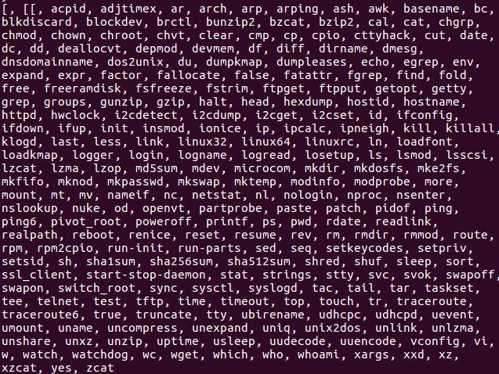
busybox - all-in-one

